Slide 1

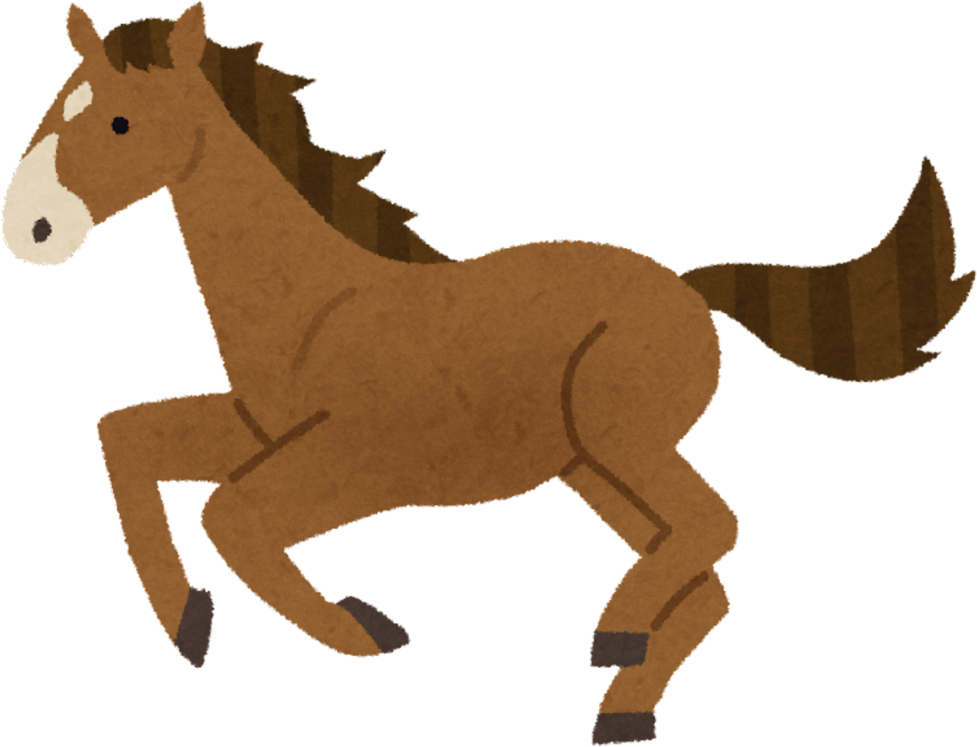
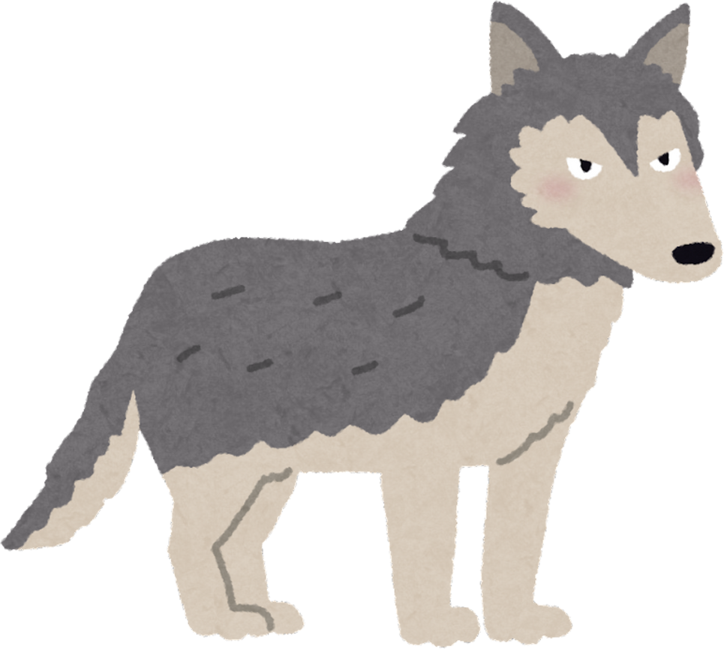
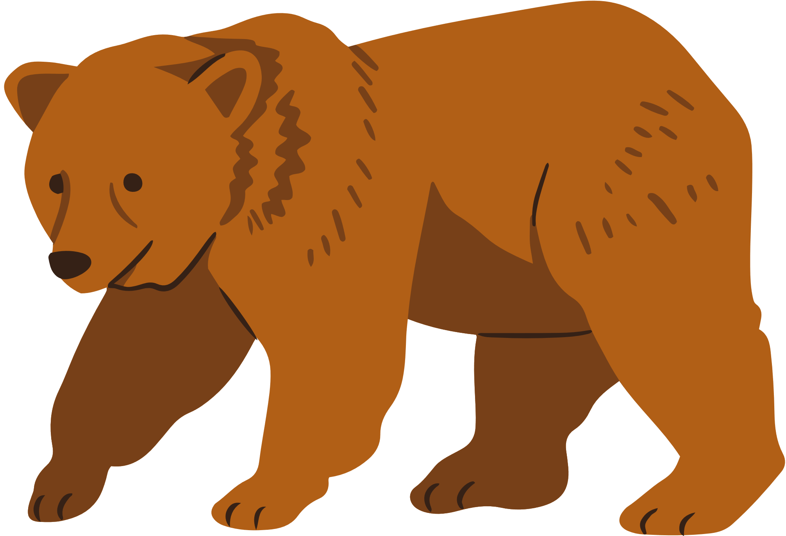
ANIMALS
WITH
CAN/CAN’T
-WORKSHEETS
-LESSON PLAN
ingilizcesinavi.com

Slide 2
ANIMALS
WITH
CAN/CAN’T
LESSON PLAN
THERE ARE PICTURES OF ANIMALS IN THE SLIDES.
-FIRST, OPEN THE FIRST SLIDE THAT DOES NOT HAVE THE NAME OF THE ANIMAL
-THEN, ASK THE STUDENTS, “WHAT IS IT?”
-AFTER THAT, ASK SOME FOLLOW-UP QUESTIONS SUCH AS, “WHAT COLOR IS IT?” AND “WHAT CAN IT DO?”
-FINALLY, CONTINUE UNTIL THE SLIDES ARE OVER.
YOU CAN GIVE THE WORKSHEETS DURING THE LESSON OR AFTER THE LESSON AS HOMEWORK.
ingilizcesinavi.com

Slide 4
Bear

Slide 5

Can bears run?

Slide 6
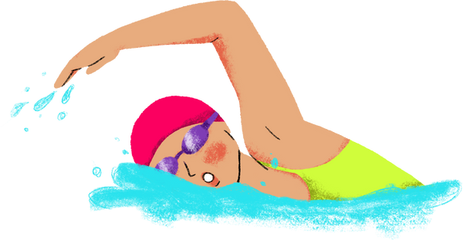
Can bears swim?

Slide 7

Can bears fly?

Slide 8
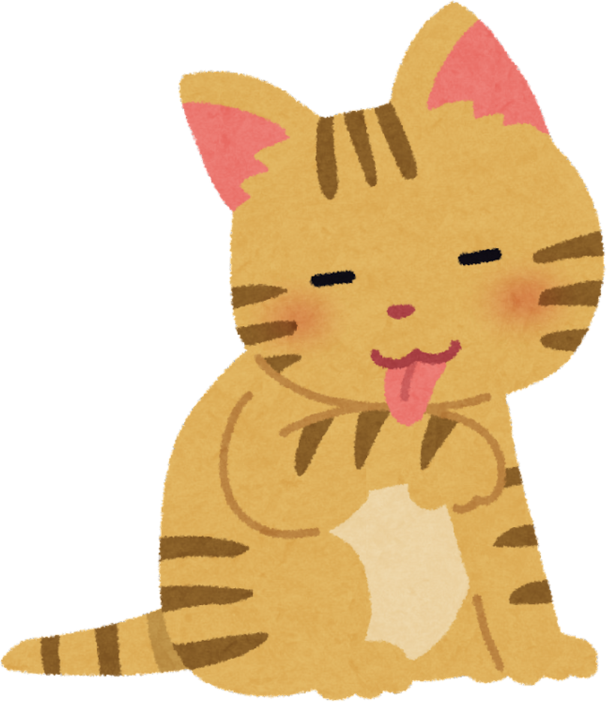

Slide 9
Cat

Slide 10
Can cats climb?

Slide 11
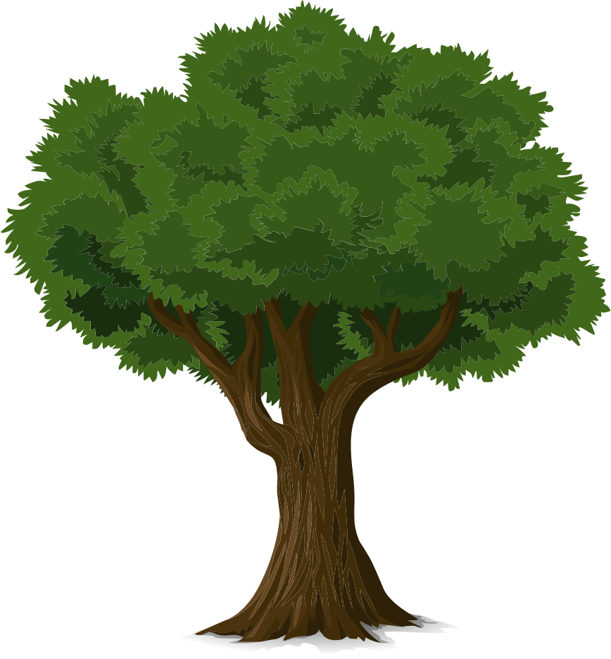
Yes, they can.

Slide 12



Can you climb a tree?
Yes, I can
No, I can’t

Slide 14
Wolf

Slide 15
Can a wolf run?

Slide 16
Can a wolf fly ?

Slide 17

No, they can’t.

Slide 18
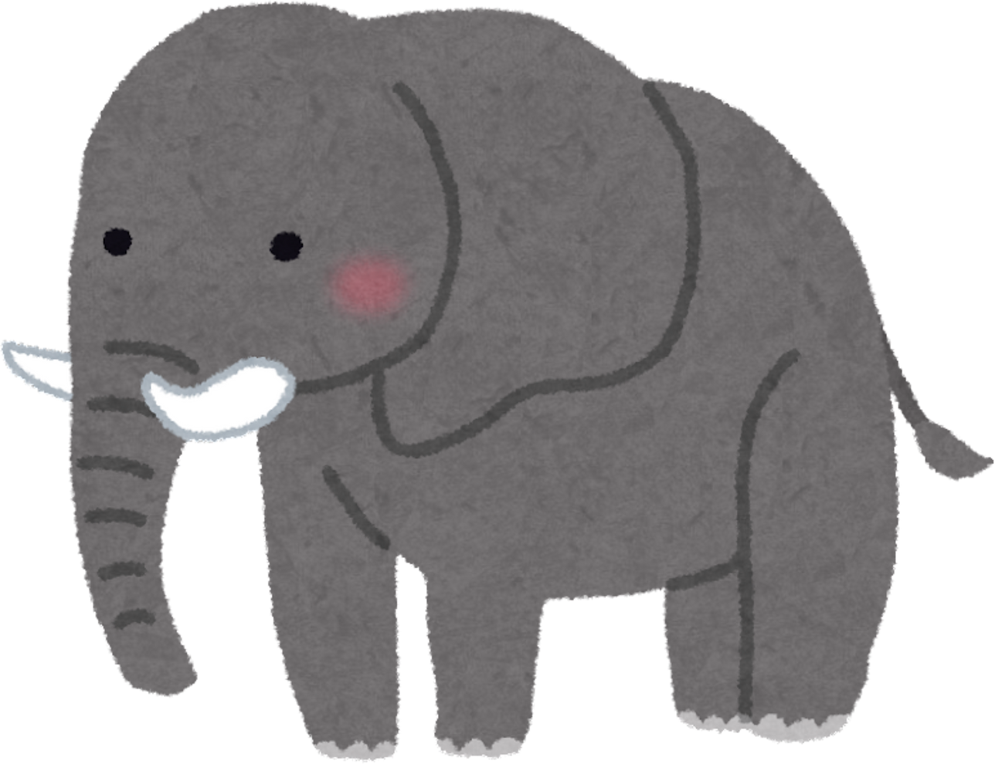

Slide 19
Elephant

Slide 20
Can elephants climb?

Slide 21
No, they can’t

Slide 22
Can elephants run?

Slide 23


Yes, they can.

Slide 24
Can you run?

Slide 26
Horse

Slide 27
Can horses walk?

Slide 28
Yes, they can.

Slide 29
Can horses climb?

Slide 30
No, they can’t.

Slide 31
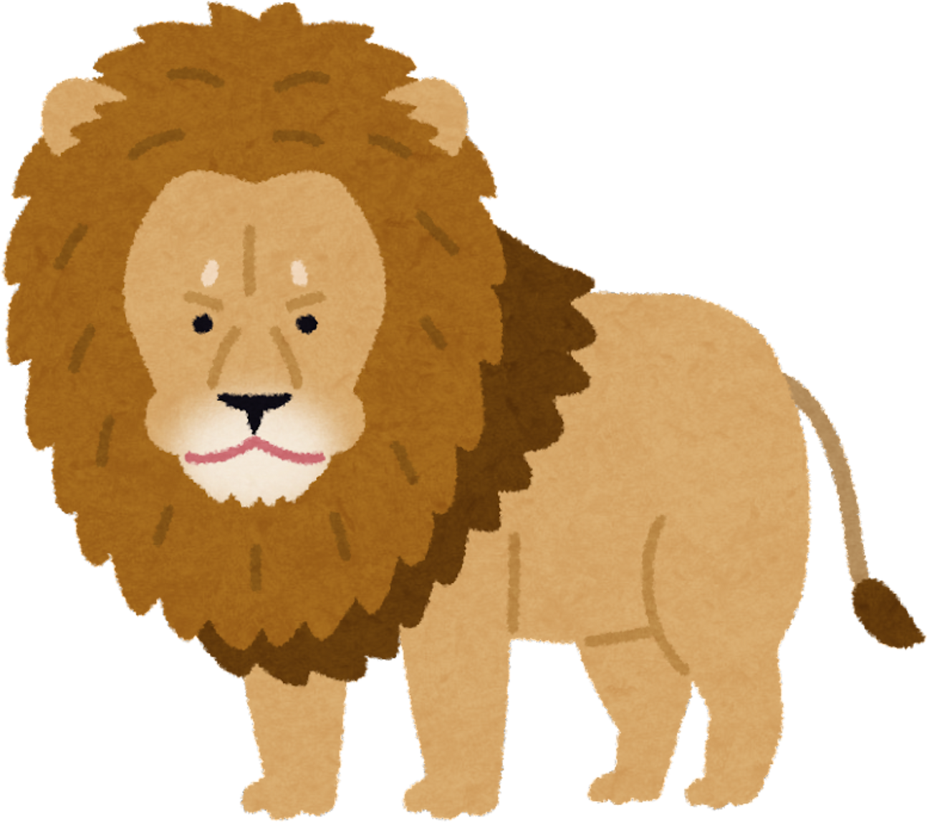

Slide 32
Lion

Slide 33

ROARRRRRRRRRRRRRRRRRR
Can lions roar?

Slide 34
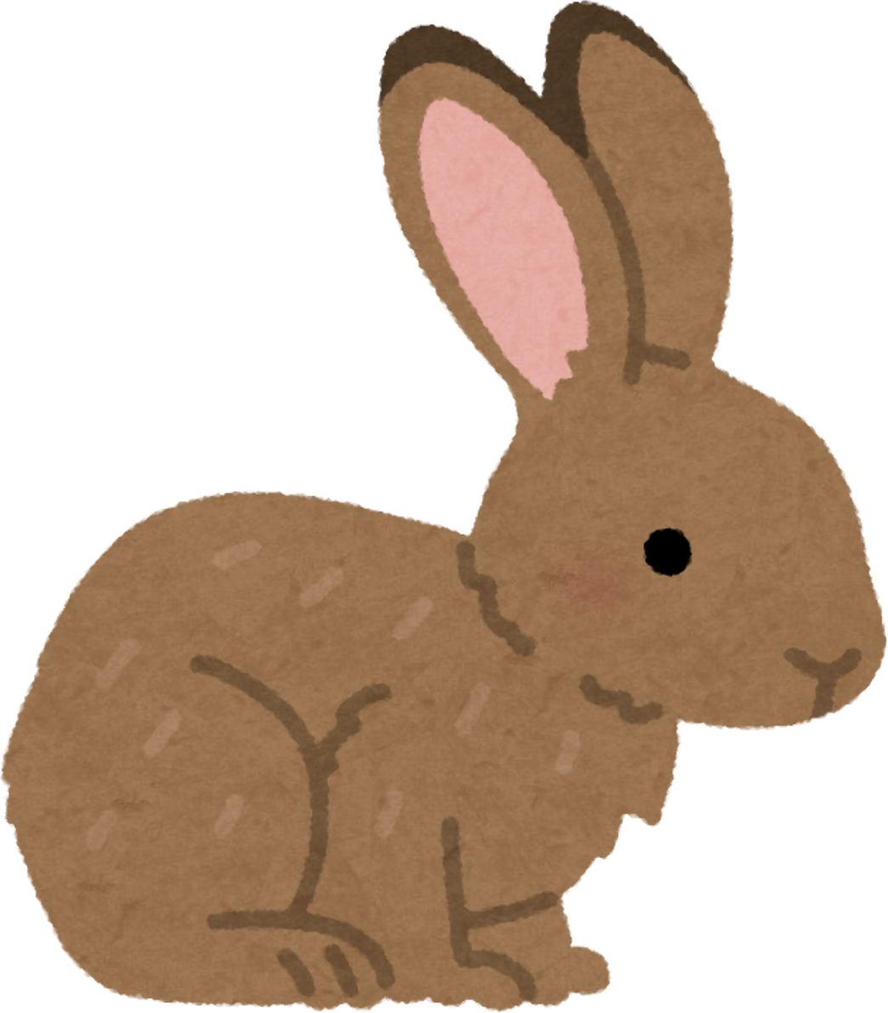
Rabbit

Slide 35
Can rabbits jump?

Slide 36


?

Slide 37
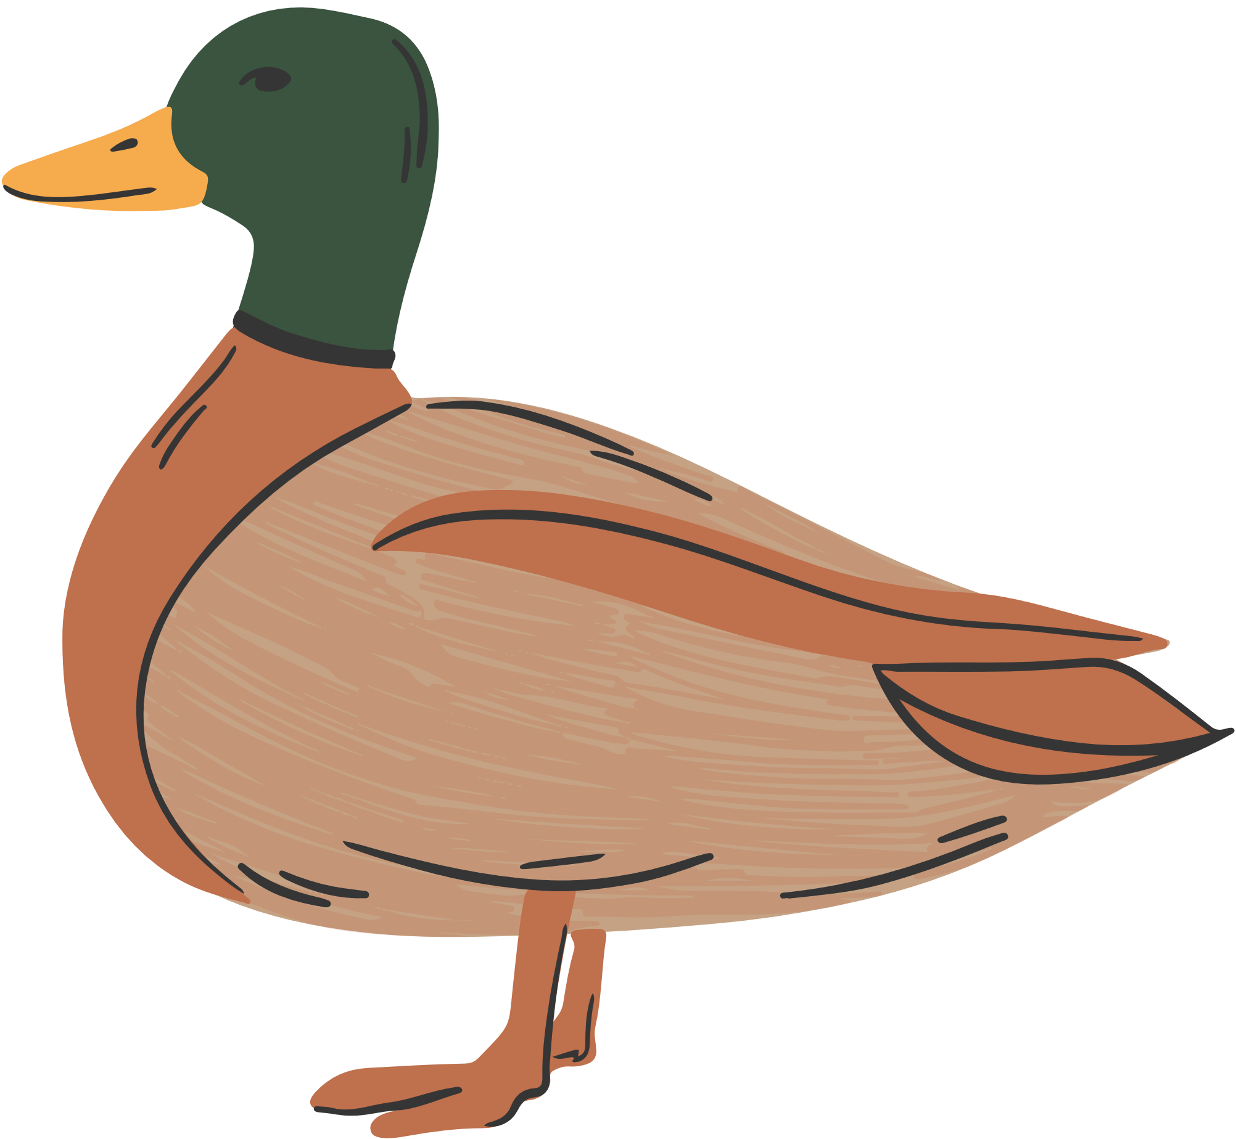

Slide 38
Duck

Slide 39
Can ducks climb?

Slide 40
Can ducks fly?

