Slide 1




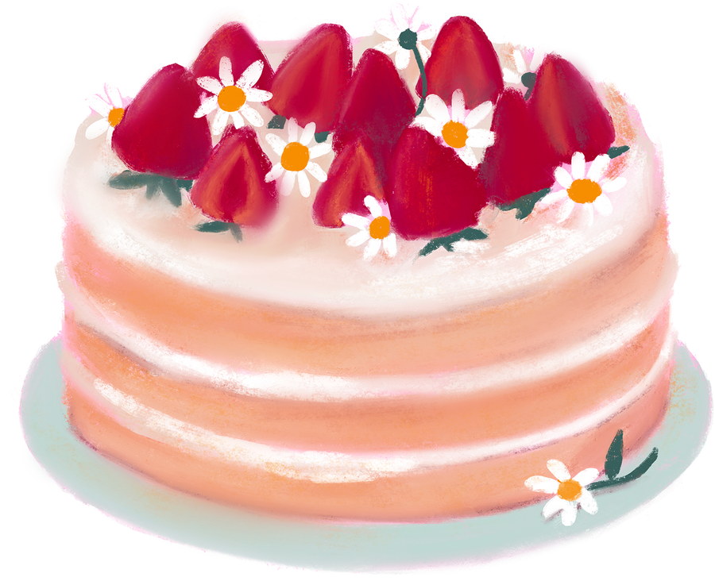
FOOD AND DRINKS
WITH
LIKE/DON’T LIKE
-WORKSHEETS
-LESSON PLAN
ingilizcesinavi.com

Slide 2
FOOD AND DRINKS
WITH
LIKE/DON’T LIKE
LESSON PLAN
THERE ARE PICTURES OF FOODS AND DRINKS IN THE SLIDES.
-FIRST, OPEN THE FIRST SLIDE THAT DOES NOT HAVE THE NAME OF THE FOOD OR DRINK.
-THEN, ASK THE STUDENTS, “WHAT IS IT?”
-AFTER THAT, ASK SOME FOLLOW-UP QUESTIONS SUCH AS, “WHAT COLOR IS IT?” AND “DO YOU LIKE IT?”
-FINALLY, CONTINUE UNTIL THE SLIDES ARE OVER.
YOU CAN GIVE THE WORKSHEETS DURING THE LESSON OR AFTER THE LESSON AS HOMEWORK.
ingilizcesinavi.com

Slide 3
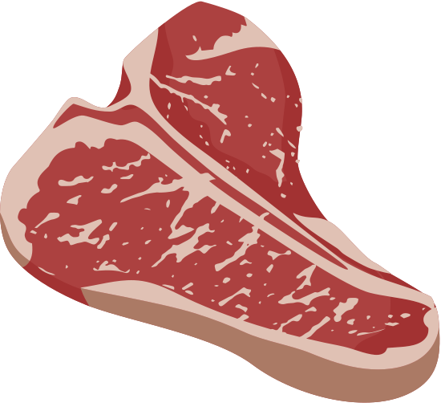

Slide 4
BEEF

Slide 6
FISH

Slide 8
EGG

Slide 9


Slide 10
CHEESE

Slide 11



Slide 12
MILK

Slide 13

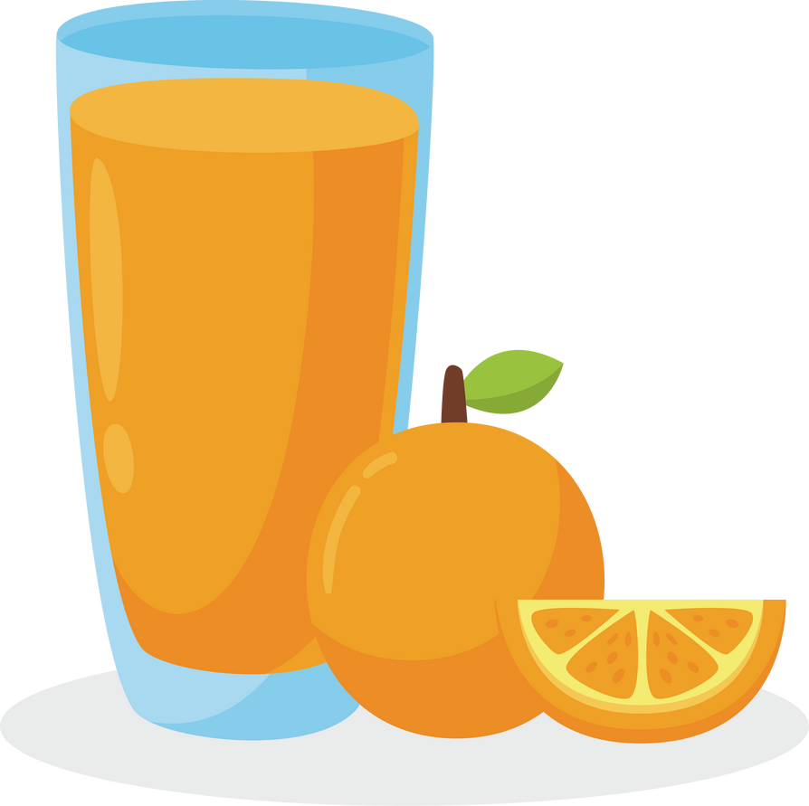

Slide 14
JUICE

Slide 16
COFFE

Slide 18
CAKE

Slide 19


Slide 20
ICE CREAM

Slide 21


Slide 22
POPCORN

Slide 23
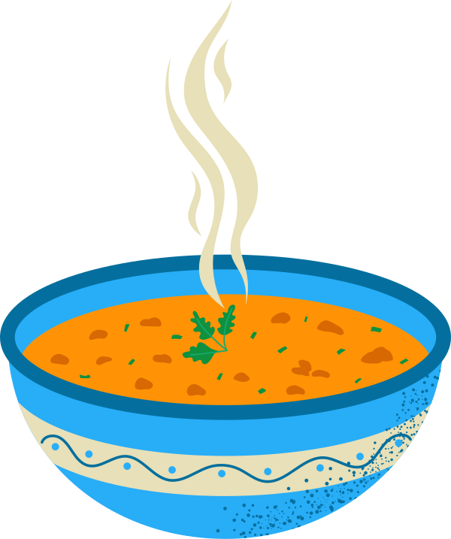

Slide 24
SOUP

Slide 25
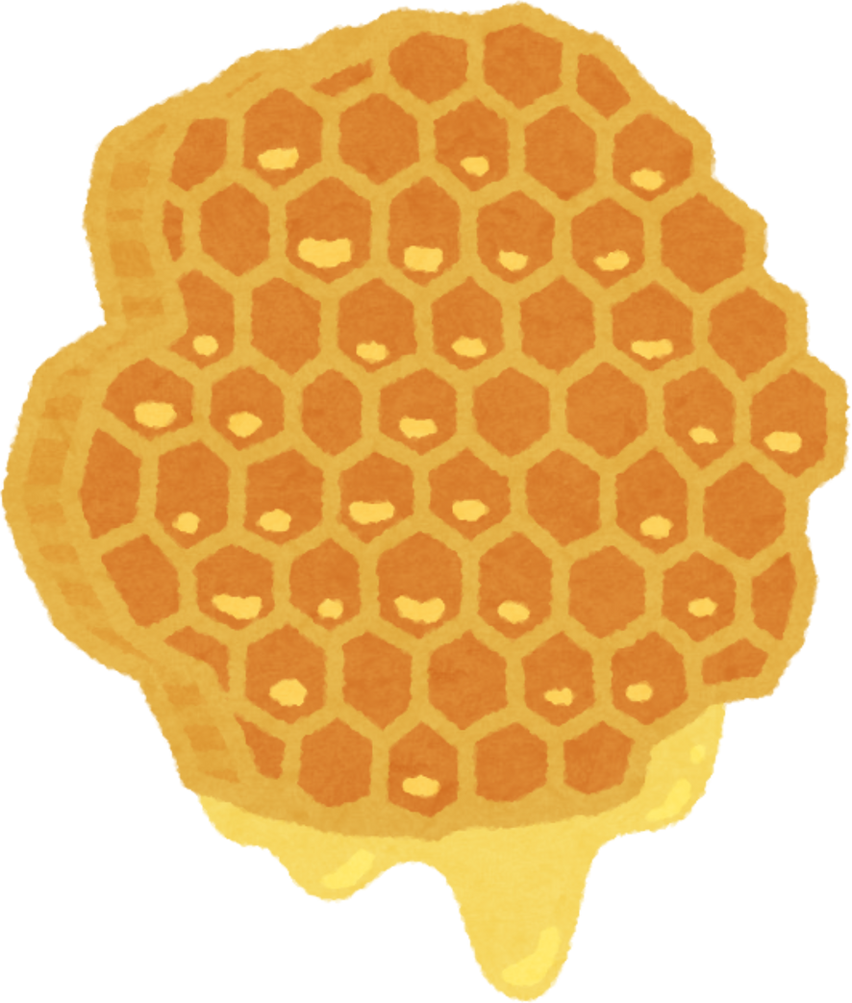


Slide 26
HONEY

Slide 27
DO YOU LIKE HONEY?

Slide 28
DO YOU LIKE SOUP?

Slide 29
DO YOU LIKE POPCORN?

Slide 30
DO YOU LIKE
ICE CREAM?

Slide 31
DO YOU LIKE CAKE?

Slide 32


Does he like coffe?

Slide 33
Does he like juice?

Slide 34

Does he like milk?

Slide 35
Does he like cheese?

Slide 36

Does she like fish?

Slide 37
Does she like beef?

