Slide 1




Rooms and
Household Items
WITH
THERE IS/THERE ARE
-WORKSHEETS
-LESSON PLAN
ingilizcesinavi.com

Slide 2
Rooms and
Household Items
WITH
THERE IS/THERE ARE
LESSON PLAN
THERE ARE PICTURES OF ROOMS AND HOUSEHOLD ITEMS IN THE SLIDES.
-FIRST, OPEN THE FIRST SLIDE THAT DOES NOT HAVE THE NAME OF THE ROOM.
-THEN, ASK THE STUDENTS, “WHAT ROOM IS IT?”
-AFTER THAT, ASK SOME FOLLOW-UP QUESTIONS SUCH AS, “WHAT DO YOU DO THERE?” AND “WHAT HOUSEHOLD ITEMS ARE THERE?”
-FINALLY, CONTINUE UNTIL THE SLIDES ARE OVER.
YOU CAN GIVE THE WORKSHEETS DURING THE LESSON OR AFTER THE LESSON AS HOMEWORK.
ingilizcesinavi.com

Slide 3



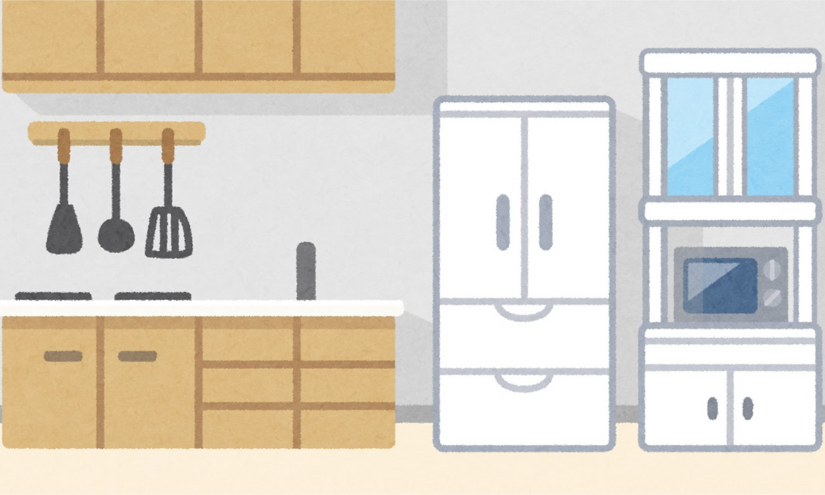
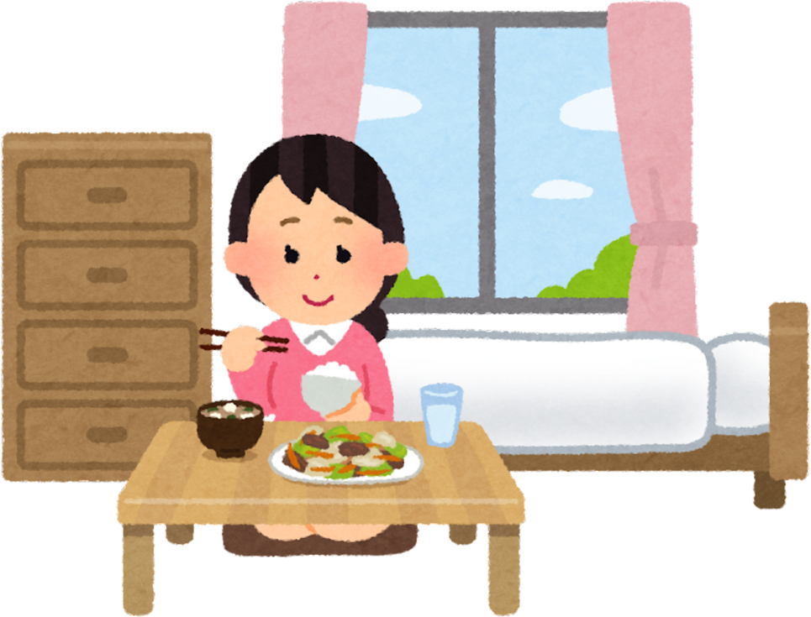

Kitchen
ROOMS
Bathroom
Bedroom
Living room

Slide 4
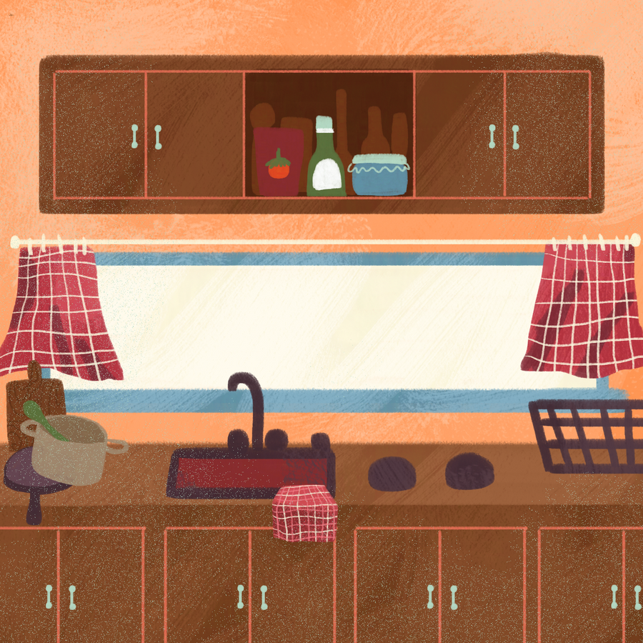

Slide 5
Kitchen

Slide 6
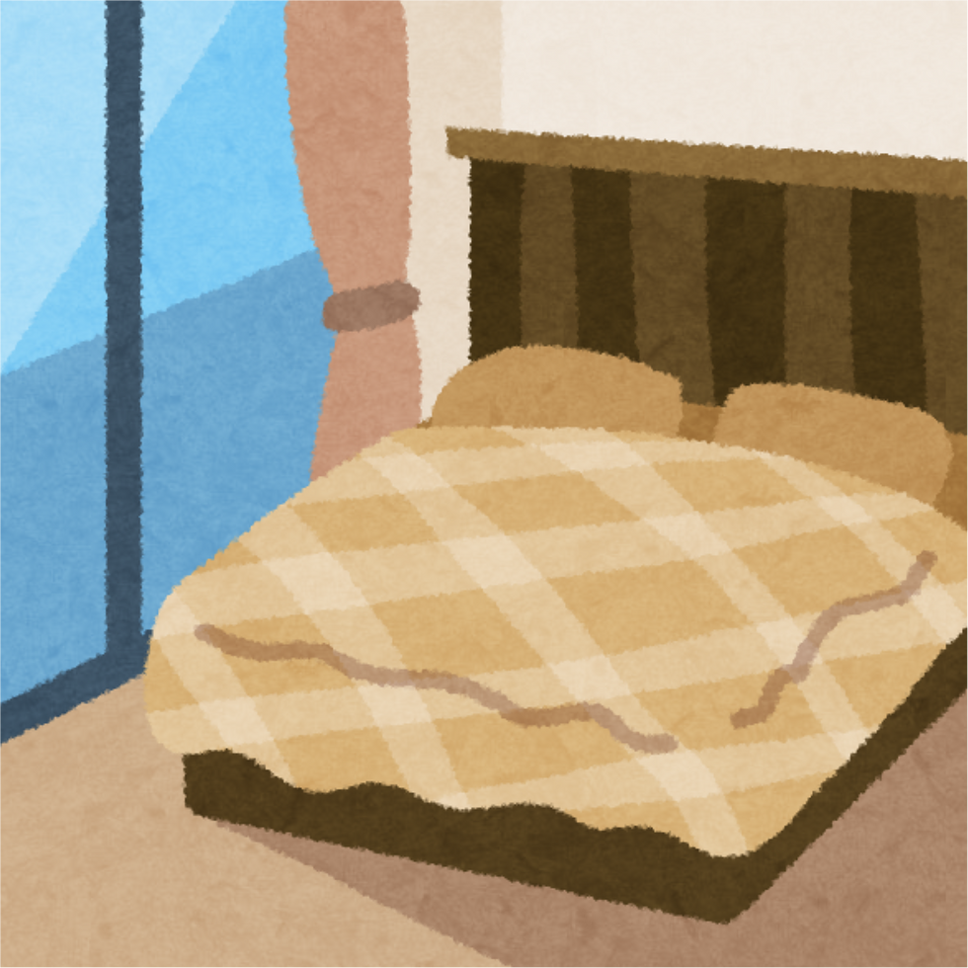

Slide 7
Bedroom

Slide 8
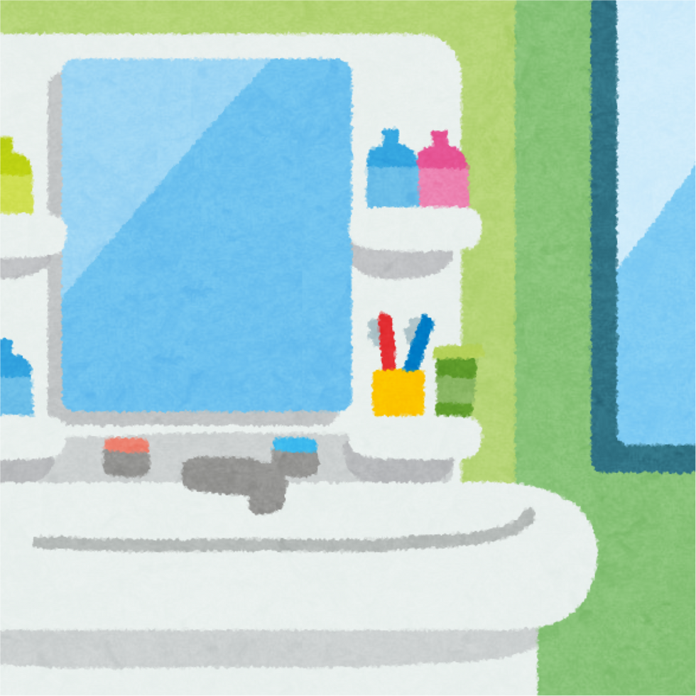

Slide 9
Bathroom

Slide 10
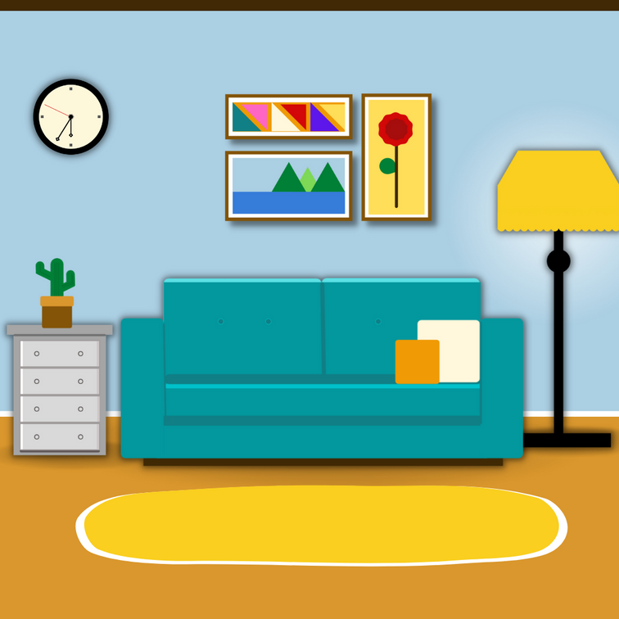

Slide 11
Living Room

Slide 12
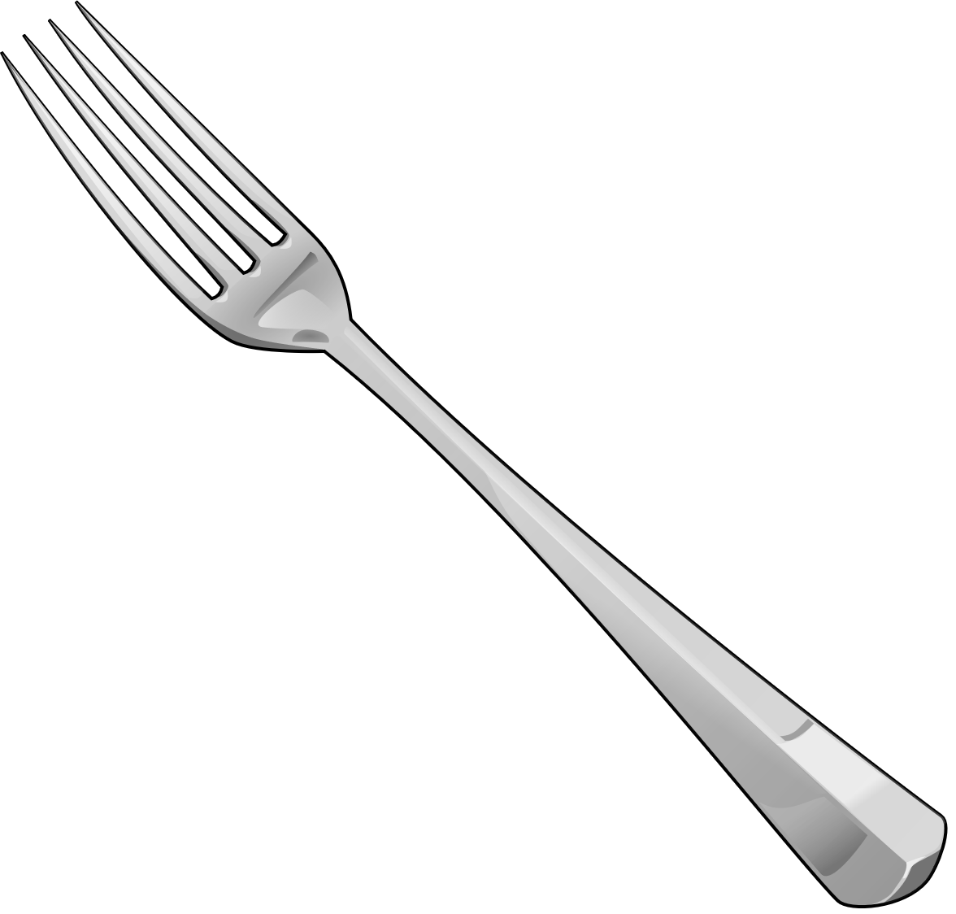


Kitchen Items

Slide 14
Spoon

Slide 16
Fork

Slide 18
Glass

Slide 20
Plate

Slide 21
How many forks are there?

Slide 22
LETS COUNT!
1
2
3
4
5

Slide 23
There are 5 forks!
1
2
3
4
5

Slide 24

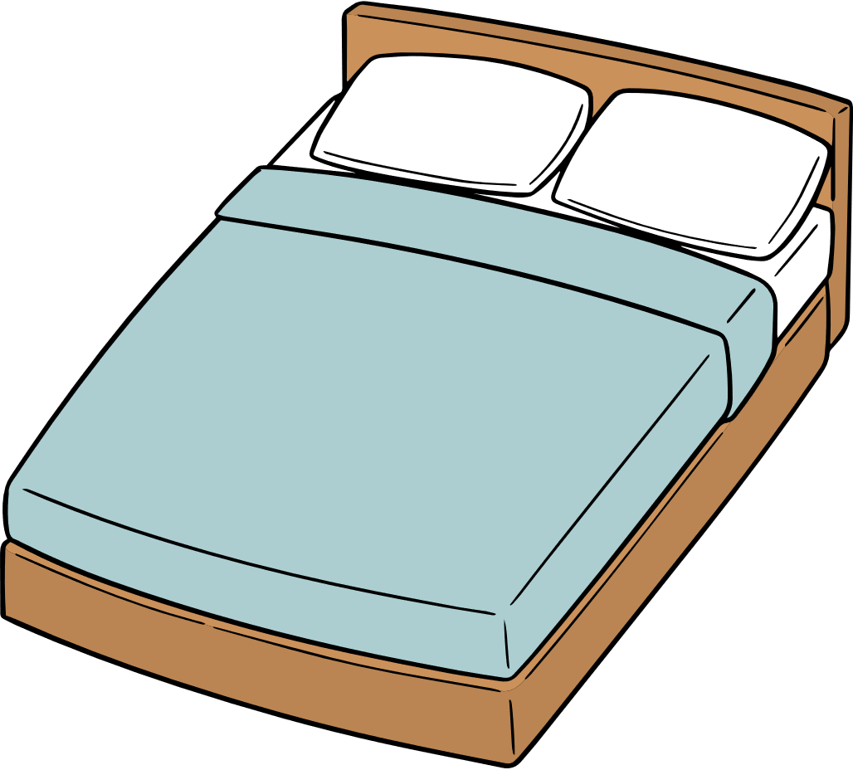
Bedroom Items

Slide 26
Bed

Slide 28
Lamp

Slide 30
Mirror

Slide 31
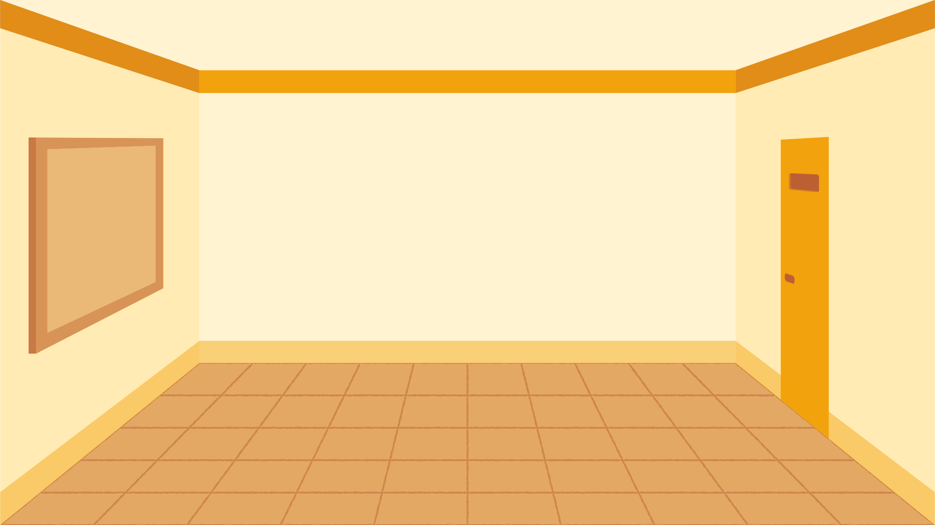
How many lamps are there?

Slide 32
LETS COUNT!
2
4
1
3
5

Slide 33
There are 5 lamps!
2
4
1
3
5

Slide 34


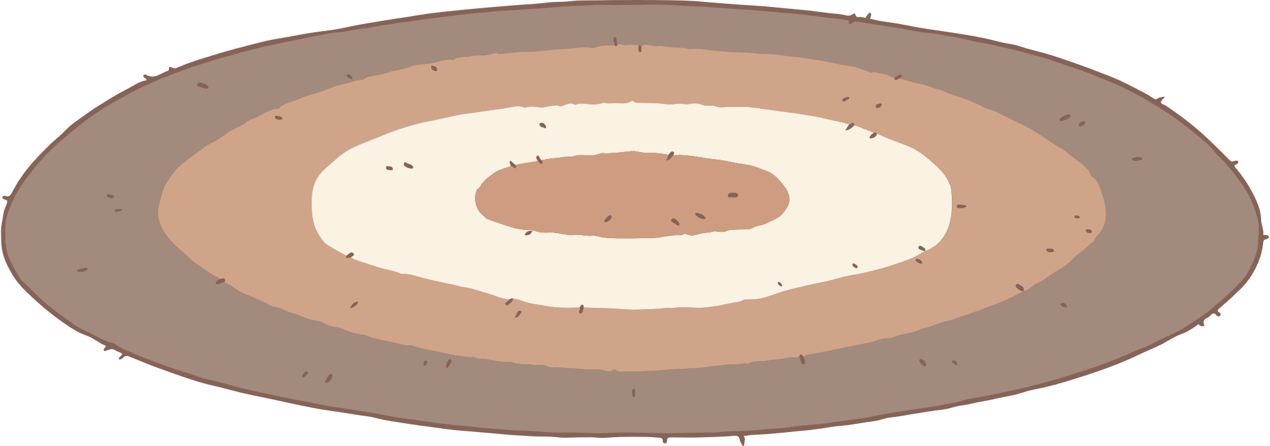
Living Room Items

Slide 36
Sofa

Slide 38
Armchair

Slide 40
Carpet

Slide 41




Bathroom Items

Slide 43
Soap

Slide 45
Toothbrush

Slide 47
Shampoo

